Slide 1
Risk Management Presented By: Prof. Shatrunjay Rawat

Slide 2
Agenda
Introduction
Risk Management
Risk Assessment
Risk Mitigation
Evaluation and Assessment
Success Factors

Slide 3
Risk Management
Risk management is the process of identifying risk, assessing risk, and taking steps to reduce risk to an acceptable level.

Slide 4
Objective
The objective of performing risk management is to
Secure the IT systems that store, process, or transmit information
Enable management to make well-informed risk management decisions
Assist management in authorizing (or accrediting) the IT systems on the basis of results of risk management.

Slide 5
Risk Vs Vulnerability & Threat
Gives rise to
Threat Agent
Exploits
Threat
Leads to
Vulnerability
Directly affect
Risk
Can damage
Assets
Exposure
Can result in
Safeguards
Prevent or reduce exposure

Slide 6
Risk Management & SDLC
Initiation
Acquisition
Implementation
Operation and maintenance
Disposal

Slide 7
Processes of Risk Management
Risk Assessment
Risk Mitigation
Evaluation and Assessment

Slide 8
Risk Assessment
Organizations use risk assessment to determine the extent of the potential threat and the risk associated with an IT system throughout its SDLC.
The output of this process helps to identify appropriate controls for reducing or eliminating risk during the risk mitigation process.

Slide 9
Risk Assessment Methodology
System Characterization
Threat Identification
Vulnerability Identification
Control Analysis
Likelihood Determination
Impact Analysis
Risk Determination
Control Recommendations
Results Documentation

Slide 10
System Characterization
The boundaries of the IT system are identified, along with the resources and the information that constitute the system.
Input
Hardware, Software, System interfaces, People, Data and information
Output
System Boundary, System Functions, System and Data Criticality, System and Data Sensitivity

Slide 11
Threat Identification
Threat-source identification
Motivation and Threat actions
Input
Previous History of system attack, Data from agencies like CERT, Web-based resources such as SANS.org, SecurityFocus.com, SecurityPortal.com etc.
Output
A threat statement containing a list of threat-sources that could exploit system vulnerabilities

Slide 12
Vulnerability Identification
Develop a list of system vulnerabilities (flaws or weaknesses) that could be exploited by the potential threat-sources.
Input
Reports of prior risk assessments and audits
Vulnerability databases, Vendor Advisories, mailing lists
Security test results ( vulnerability scanners)
Output
List of Potential Vulnerabilities

Slide 13
Control Analysis
To analyze the controls that have been implemented, or are planned for implementation to minimize or eliminate the risk
Input
Current controls and Planned Controls
Output
List of current or planned controls used for the IT system to reduce or mitigate the risk

Slide 14
Likelihood Determination
To derive an overall likelihood rating that indicates the probability that a potential vulnerability may be exercised
Likelihood Rating – HIGH, MEDIUM, LOW
Input
Threat-source motivation, Threat capacity, Nature of vulnerability, Current controls
Output
Likelihood Rating

Slide 15
Impact Analysis
To determine the adverse impact resulting from a successful threat exercise of a vulnerability
Magnitude of Impact – HIGH, MEDIUM, LOW
Input
Asset criticality assessment, Data criticality or Data sensitivity
Output
Impact Rating

Slide 16
Risk Determination
To assess the level of risk to the IT system
Function of
The likelihood of a given threat attempting to exploit a given vulnerability
The magnitude of the impact if a threat successfully exploits the vulnerability
The adequacy of planned or existing security controls for reducing or eliminating risk
Risk level matrix and Risk Scale

Slide 17
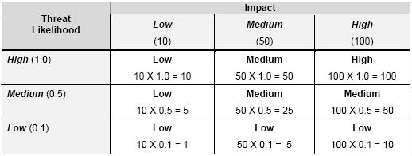
Risk Determination – Risk level Matrix

Slide 18
Risk Determination – Risk Scale
Risk Scale
HIGH >50 to 100
MEDIUM >10 to 50
LOW 1 to 10

Slide 19
Control Recommendations
The goal of the recommended controls is to reduce the level of risk to the IT system and its data to an acceptable level
Factors to be considered
Effectiveness of recommended options (e.g., system compatibility)
Legislation and regulation
Organizational policy
Operational impact
Safety and reliability

Slide 20
Results Documentation
Risk assessment report that describes the threats and vulnerabilities,measures the risk, and provides recommendations for control implementation

Slide 21
Risk Mitigation
Involves prioritizing, evaluating, and implementing the appropriate risk-reducing controls recommended from the risk assessment process
The elimination of all risk is usually impractical or close to impossible
Implement the most appropriate controls to decrease risk to an acceptable level

Slide 22
Risk Mitigation Options
Risk Assumption
To accept the potential risk
Risk Avoidance
To avoid the risk by eliminating the risk cause
Risk Limitation
To limit the risk by implementing controls that minimize the impact
Risk Transfer
To transfer the risk by using options to compensate for the loss

Slide 23
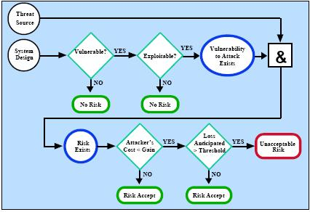
Risk Mitigation Strategy

Slide 24
Approach for Control Implementation
Prioritize Actions
Evaluate Recommended Control Options
Conduct Cost-Benefit Analysis
Select Control
Assign Responsibility
Develop a Safeguard Implementation Plan
Implement Selected Control(s)

Slide 25
Control Categories
Technical Security Controls
Management Security Controls
Operational Security Controls

Slide 26
Cost-Benefit Analysis
Qualitative Analysis
Quantitative Analysis
Residual Risk

Slide 27
Evaluation and Assessment
Risk Management is ongoing and adapting
Scheduled, periodic re-assessing and mitigating risks
Flexible to allow changes when warranted

Slide 28
Success Factors
Senior management commitment
Support and participation of the IT team
Competence of the risk assessment team
Awareness and cooperation of users
Ongoing assessment of the risks

Slide 29
Thank you!

